Slide 1
University of Arizona - Data Science Bootcamp
Superfund Sites by State Vs. Cancer Rates
Group Members:
Brenda Daly
Bryan Paynich
Anthony Mutwol
Frank Garcia

Slide 2
What is the main research question?
Is there a higher incident of cancer in states that contain a high number of superfund sites?
Hypothesis:
Due to the negative environmental impact of Superfund sites, the rate of cancer will be higher in the States that have a higher number of Superfund sites.

Slide 3
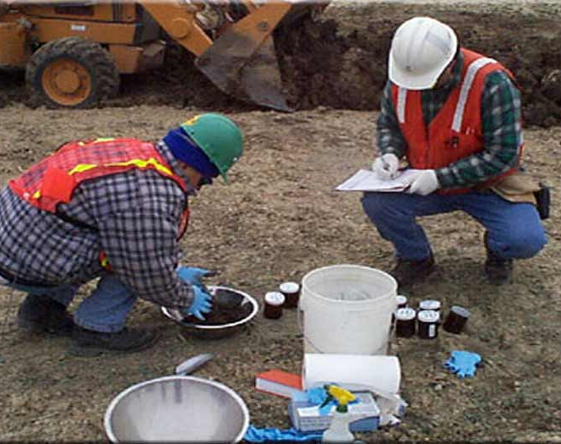
What is a Superfund site?
A Superfund site is a designation given to a polluted area by the U.S. Government.
The EPA came up with the SUPERFUND program to help clean the hazardous materials.
Superfund Goals:
Protect human health and environment by cleaning up the contaminated sites.
Make responsible parties pay and clean up.
Return Superfund sites to productive use.

Slide 4
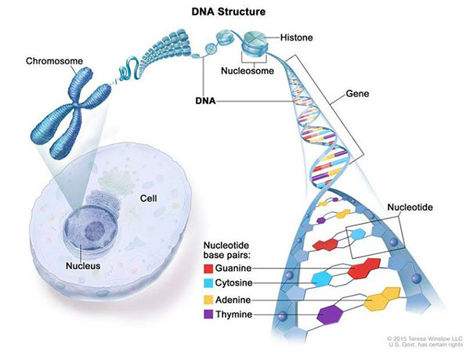
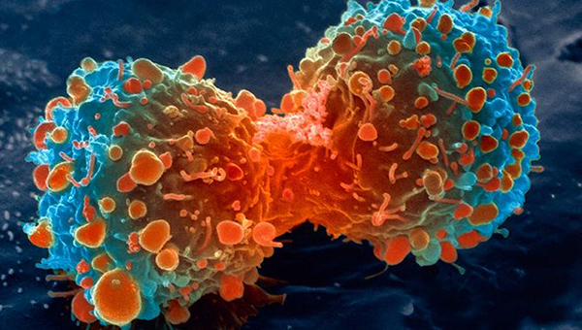
What is Cancer?
Cancer is a genetic disease that is caused by changes to genes that control the way a cell grows, function and how they divide.

Slide 5
Cancer Types
In this project we look to correlate the top four Cancer types with the existence of Superfund Sites:
Lung Cancer
Colon Cancer
Breast Cancer
Prostate Cancer

Slide 6
Methodology for Data Gathering

Slide 7
Data sources
Kaggle Superfund site JSON
Data source provided Latitude and longitude of all the Superfund sites based on addresses. There are 1344 active superfund sites
www.kaggle.com
Cancer incidence rates
Data source provided Cancer incident rates for each state for multiple types of cancers
https://statecancerprofiles.cancer.gov/
Team picked the top four cancer types. Downloaded csv files for each type. Combined all cancer information into one csv.

Slide 8
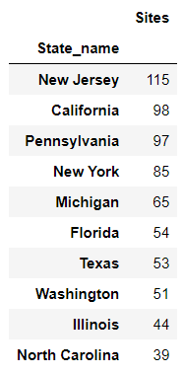
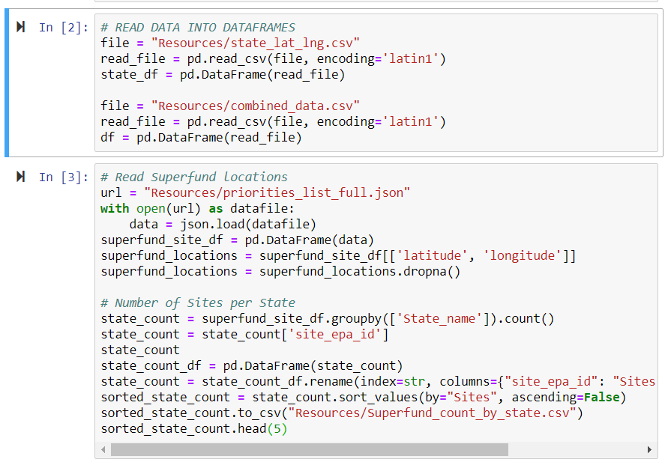
Data wrangling
Read Superfund JSON
Superfund Site Json
Built dataframe of Superfund sites per state
Read Cancer data per state
Data was displayed per state
Each team member created csv files per state and created 204 total csv files (1 for each state per cancer type)
Wrote Python routine to read in each state csv and merge data into on combined cancer set per state

Slide 9
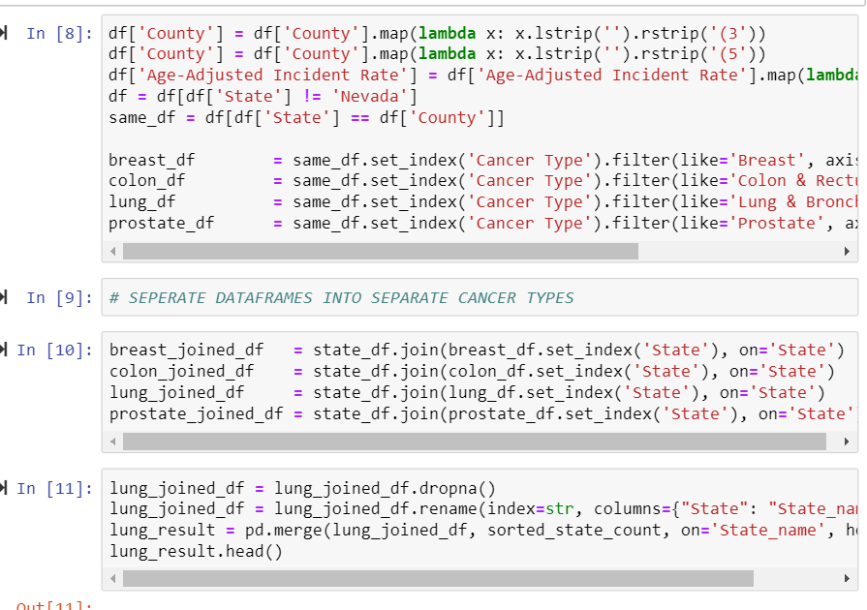
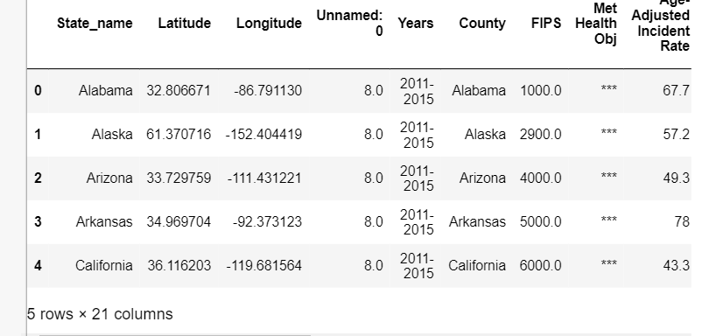
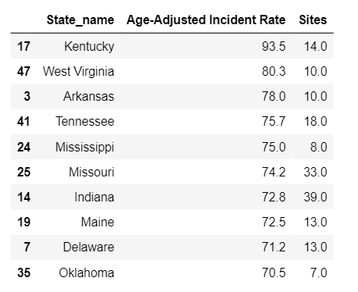
Data wrangling
Split Data into 4 data sets, each set contained all cancer types for all 50 states.
Merged lat/lng information into each dataframe for each cancer type
Created subset of each cancer type with Incident Rate and Superfund count per state
Created Scatter plots for each Cancer type and looked for correlations visually.
Fed each of the reduced dataframes into the Pearson correlation function to look for correlations statistically
The Pearson product-moment correlation coefficient is a measure of the strength of the linear relationship between two variables. It is referred to as Pearson's correlation or simply as the correlation coefficient. ... A perfect positive linear relationship, r = 1.

Slide 10
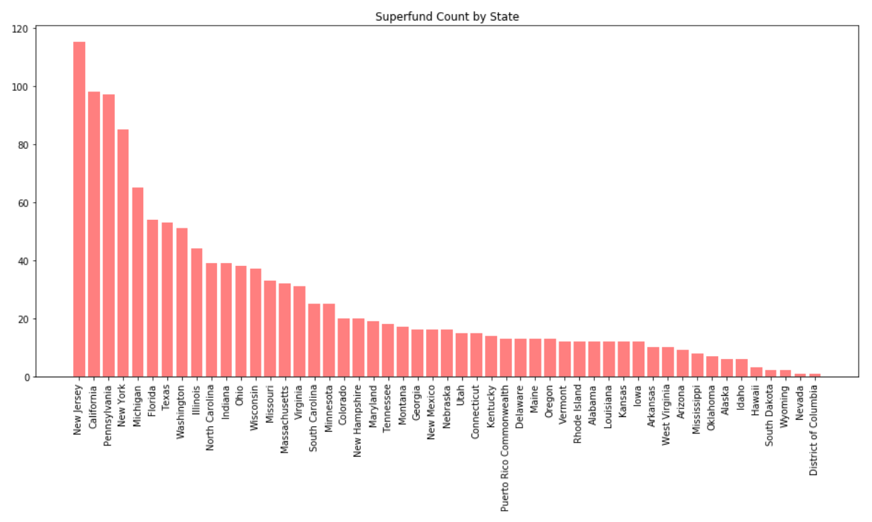
Superfund count per State

Slide 11
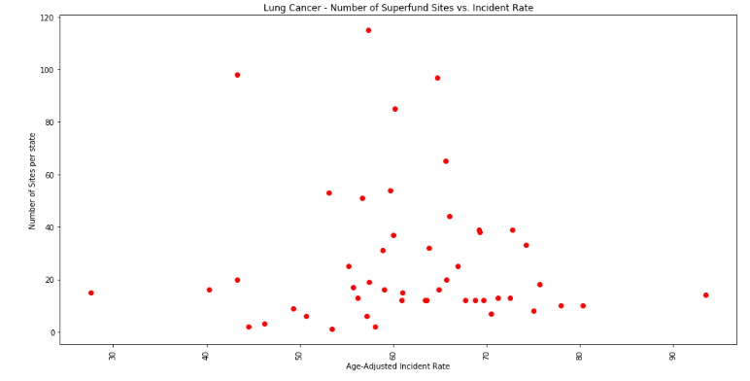
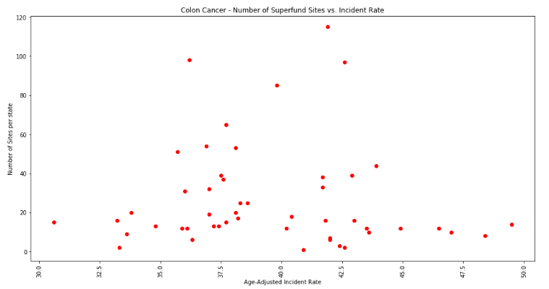
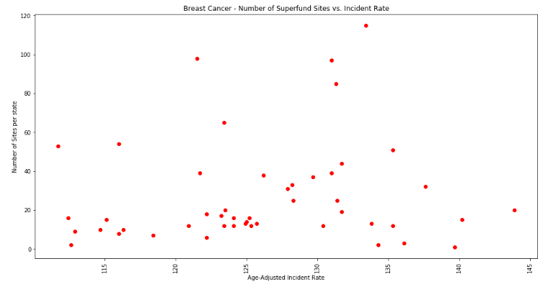
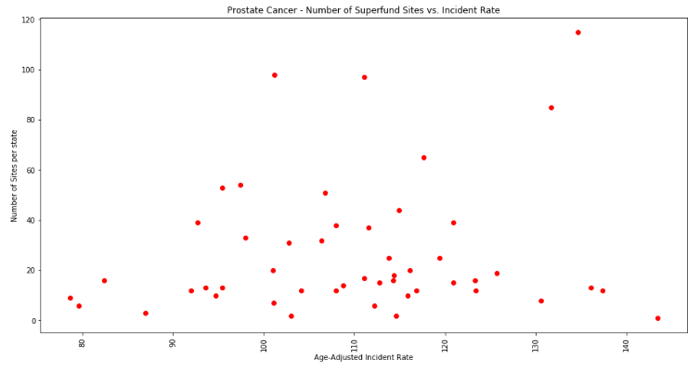
Scatter Plots correlation

Slide 12
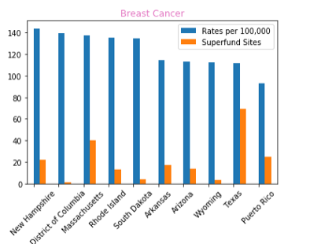
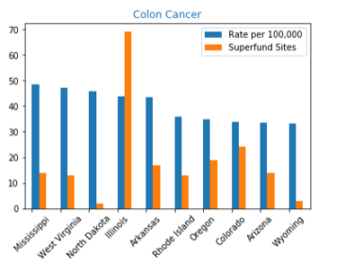
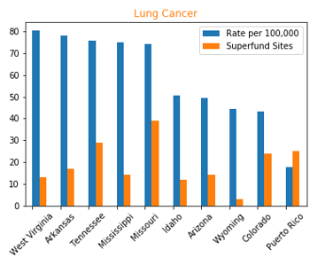
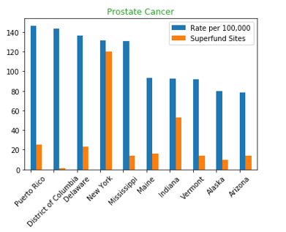
BAR CHART CORRELATION

Slide 13
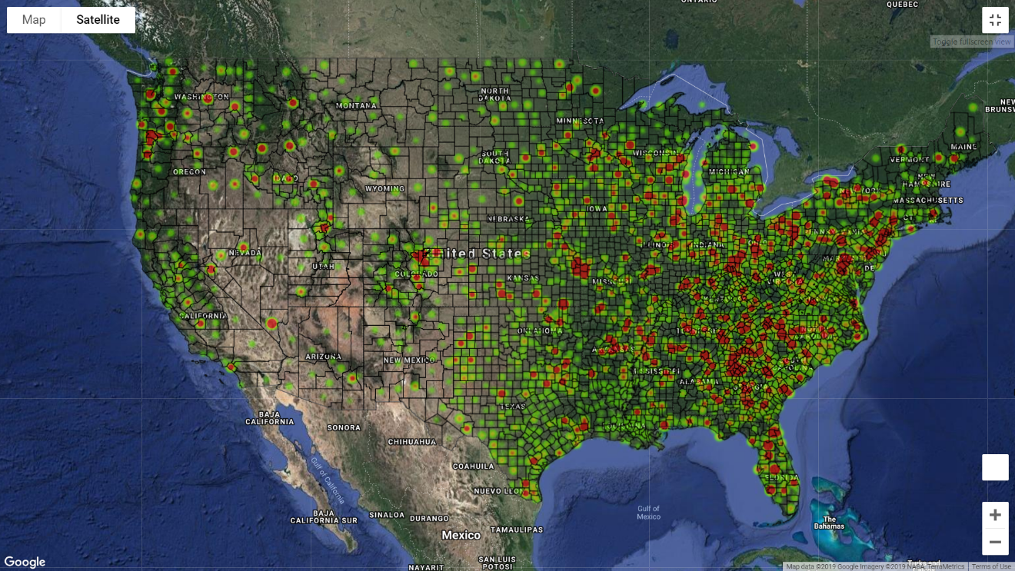
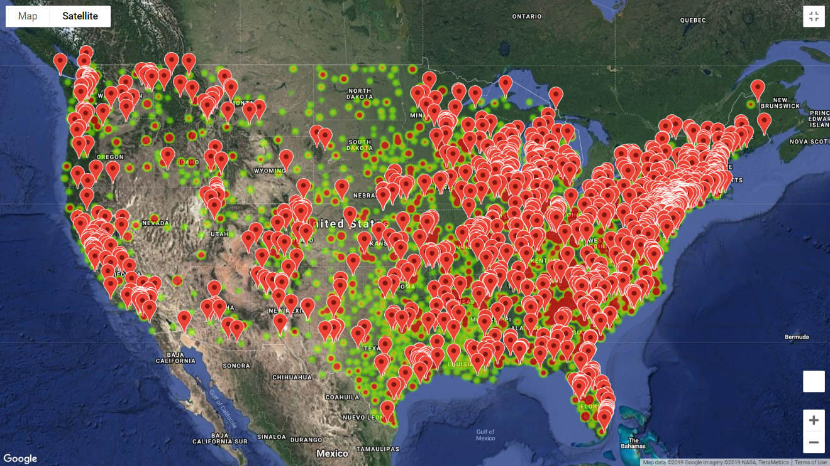
Visualizations
Created visualizations using heat maps and marker locations to search for correlations on a map for each cancer type
Read cancer data and Superfund JSON data
Used Google API functionality to generate a heatmap layer, location marker layer, and geojson layer to visualize the county boarders all on the same map.

Slide 14
Scatter plot results per cancer Type

Slide 15
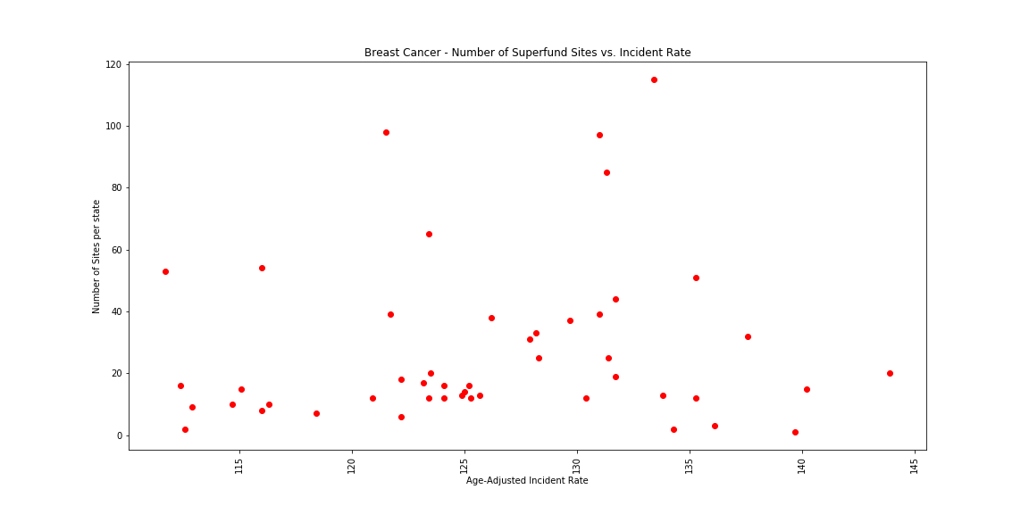
Breast Cancer Scatter Plot
Pearson correlation value: 0.11
1.0 = perfect corrlelation

Slide 16
State Incident Rates compared to total Superfund Sites
Top and bottom five states per incident rate – Breast Cancer

Slide 17
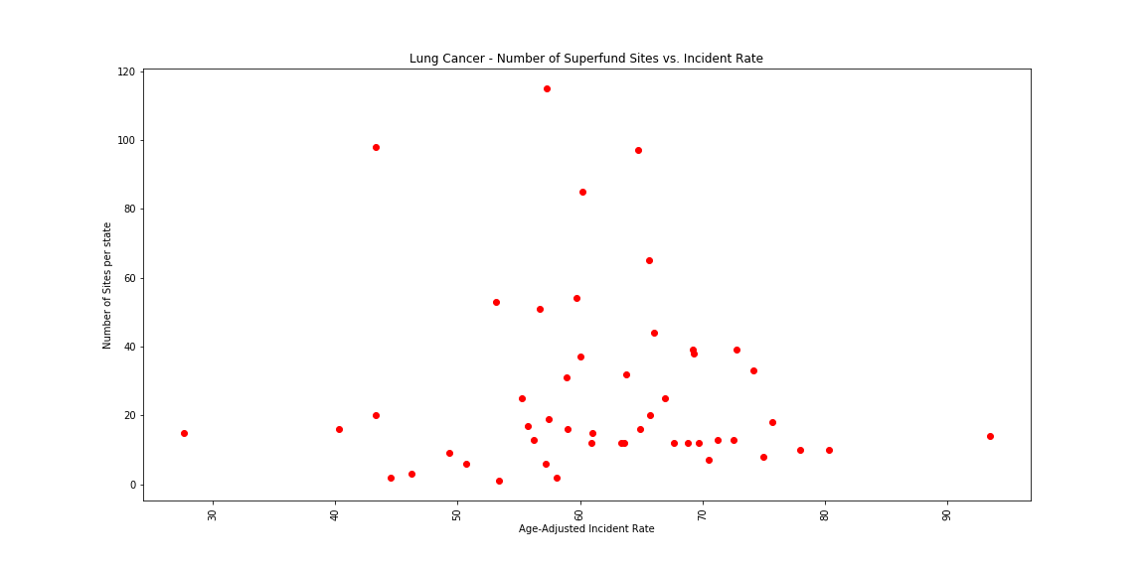
LUNG Cancer Scatter Plot
Pearson correlation value: 0.06
1.0 = perfect corrlelation

Slide 18
State Incident Rates compared to total Superfund Sites
Top and bottom five states per incident rate – Lung Cancer

Slide 19
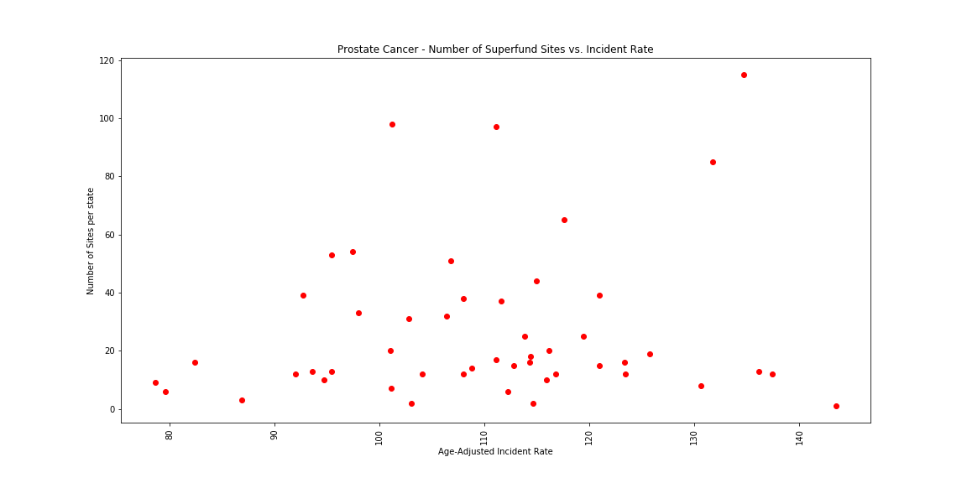
PROSTATE Cancer Scatter Plot
Pearson correlation value: 0.13
1.0 = perfect corrlelation

Slide 20
State Incident Rates compared to total Superfund Sites
Top and bottom five states per incident rate – Prostate Cancer

Slide 21
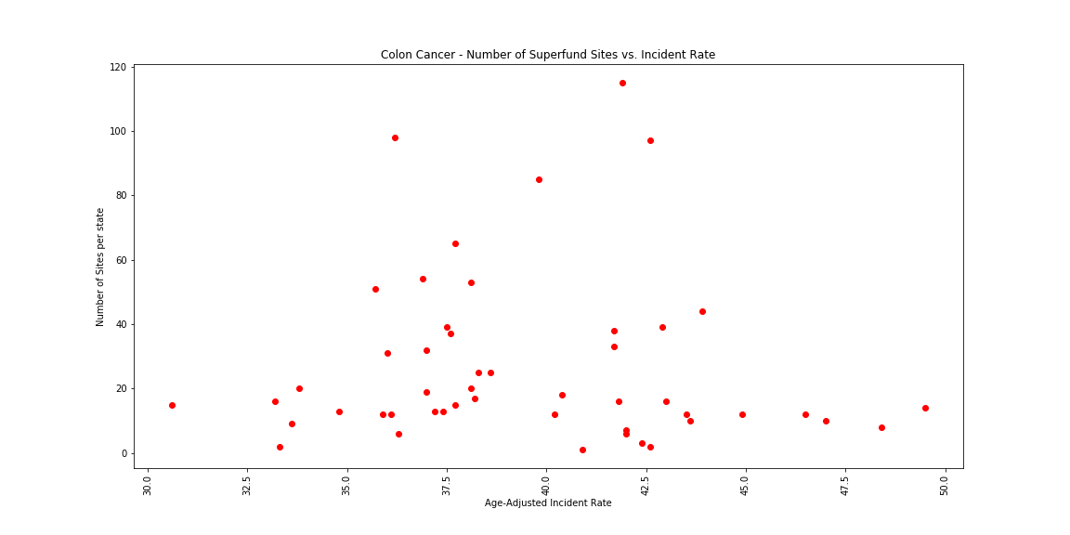
COLON Cancer Scatter Plot
Pearson correlation value: 0.04
1.0 = perfect corrlelation

Slide 22
State Incident Rates compared to total Superfund Sites
Top and bottom five states per incident rate – Colon Cancer

Slide 23
Heatmap results

Slide 24

Cancer HEATMAP Plot

Slide 25
Cancer HEATMAP Plot
Appears to be higher cancer rate towards the East

Slide 26
Cancer HEATMAP Plot
And on the coasts

Slide 27
Cancer HEATMAP Plot
And in the south

Slide 28

Cancer HEATMAP Plot
Heatmap with Superfund Markers

Slide 29
Cancer HEATMAP Plot
Large areas with high cancer rates but no Superfund sites

Slide 30
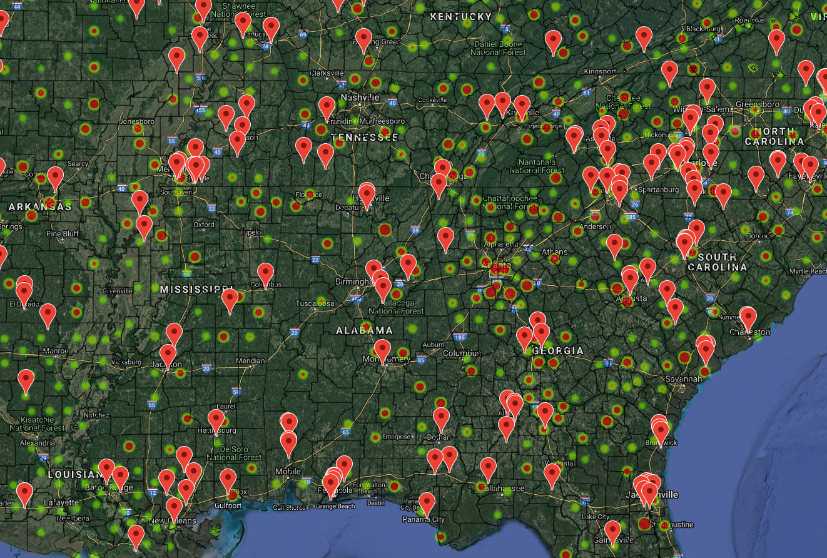
Large areas with high cancer rates but no Superfund sites

Slide 31
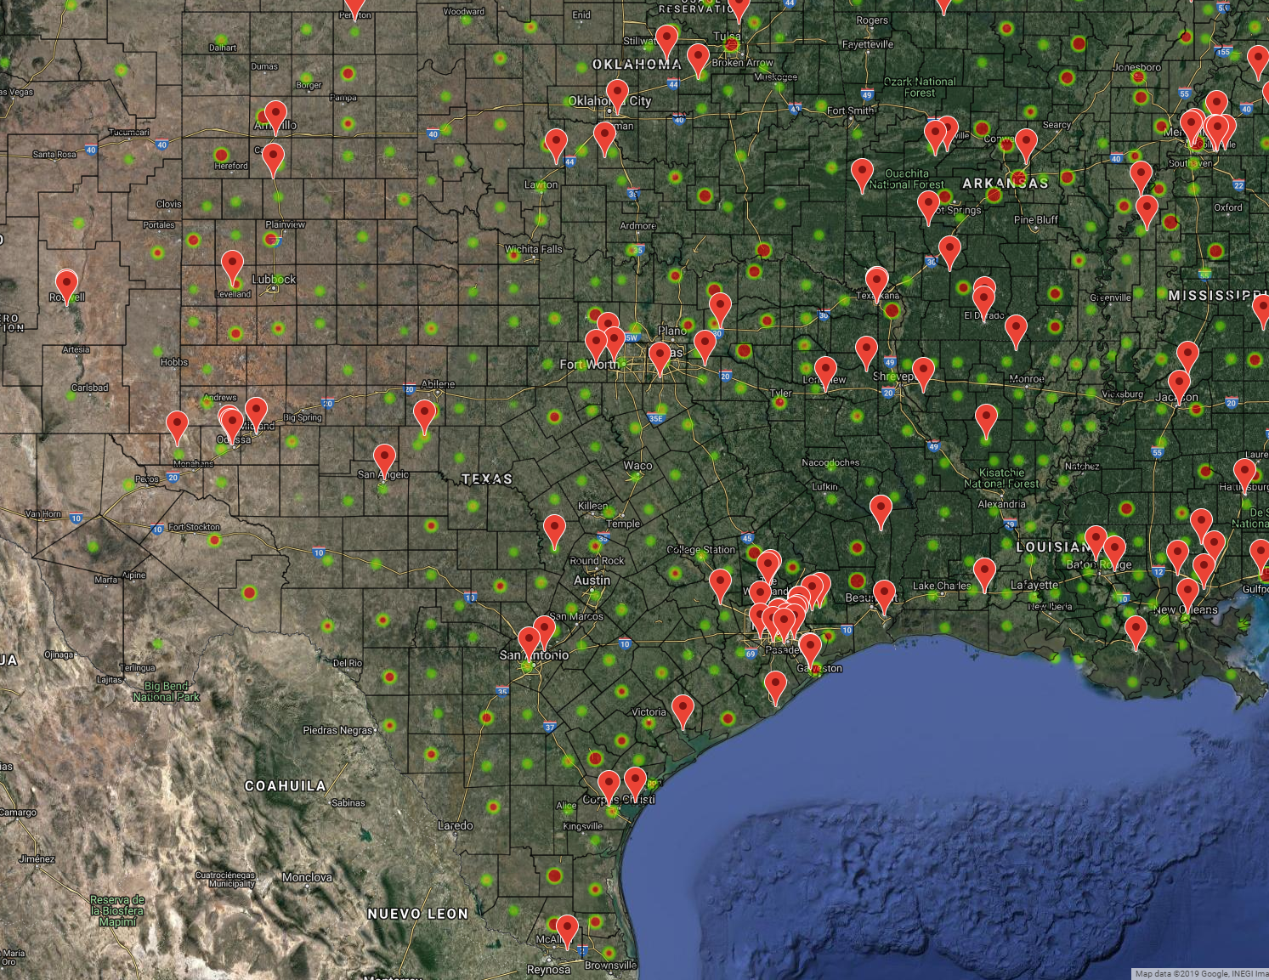
Large areas with high cancer rates but no Superfund sites

Slide 32
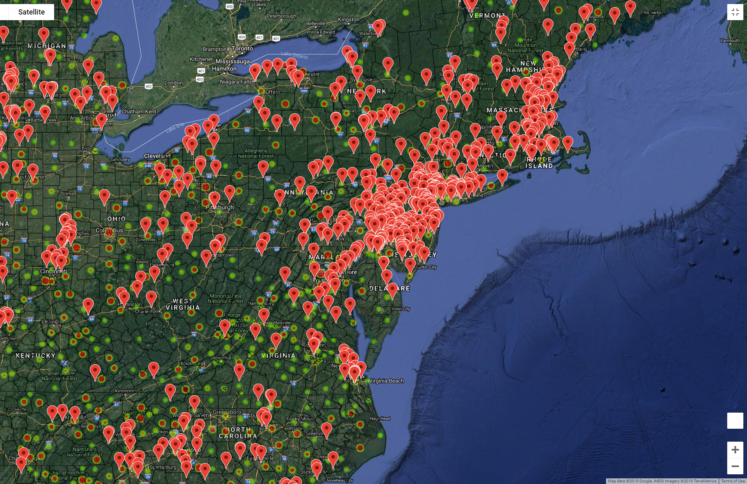
Interesting how the Superfund sites cluster in high industrial areas like: New Jersey, Chicago, Detroit.

Slide 33
Conclusions

Slide 34
Cancer incidents in relation to superfund sites
Is there a higher incident of cancer in counties that contain a Superfund site?
This is the main research question that was answered. Our hypothesis is:
Due to the negative environment impact of Superfund sites, the expectation is that cancer rates will be higher in the counties that contain Superfund site designations.
The Results:
After analyzing the scatter plot distribution and Pearson score for each cancer type, the data shows that there is no substantial correlation between Superfund sites and incidents of cancer geographically in the United States.

Slide 35
Hypothesis Rejection:
According to the data displayed above, it makes a good case for the hypothesis to be rejected. For instance, New Jersey has the highest number of superfund sites and based on our hypothesis was expected to have the highest incidence of cancer. In another example, Puerto Rico has the highest incidence of cancer yet there are few Superfund site in that locality.
The Pearson score for breast, lung, prostate, and colon cancers was extremely low suggesting little to non-existent correlation. The scores reported are 0.11, 0.06, 0.13, and 0.04 respectively.

Slide 36
Interesting insights
Top five states with most Superfund sites
New Jersey 150 Pennsylvania 127 New York 120 California 114 Florida 92
Top five states of cancer incidents
Colon Cancer
Mississippi 48.4
West Virginia 47.0
North Dakota 45.7
Illinois 43.9
Arkansas 43.6
Prostate Cancer
Puerto Rico 146.6
Washington D.C 143.5
Delaware 136.1
New York 131.7
Mississippi 130.6
Breast Cancer
New Hampshire 143.9
Washington D.C. 139.7
Massachusetts 137.6
Rhode Island 135.3
South Dakota 134.3
Lung Cancer
West Virginia 80.3
Arkansas 78.0
Tennessee 75.7
Mississippi 75.0
Missouri 74.2
Incidence rates (cases per 100,000 population per year)

Slide 37
How does Arizona measure up?
Arizona is in the bottom five states of cancer incidence for all four cancer types researched. Second lowest was Wyoming.
Breast cancer 112.9
Colon cancer 33.6
Lung 49.3
Prostate 78.6
Incidence rates (cases per 100,000 population per year)

Slide 38
Further Research
Now that we have come to this conclusion, what additional data sets can we use to correlate cancer rates in each of the 50 states:
Specific diets in different parts of the country?
Obesity?
Tobacco use
Hours worked per week?
Industry worked in?

